Slide 1
Cost Effective Presto on AWS
with Spot Nodes
Strata Data Conference
March 2019
Shubham Tagra (stagra@qubole.com)

Slide 2
Agenda
Introduction to Presto and Spot Nodes
Problems with Presto on Spot Nodes
Qubole's journey of Presto on Spot Nodes
Case study

Slide 3
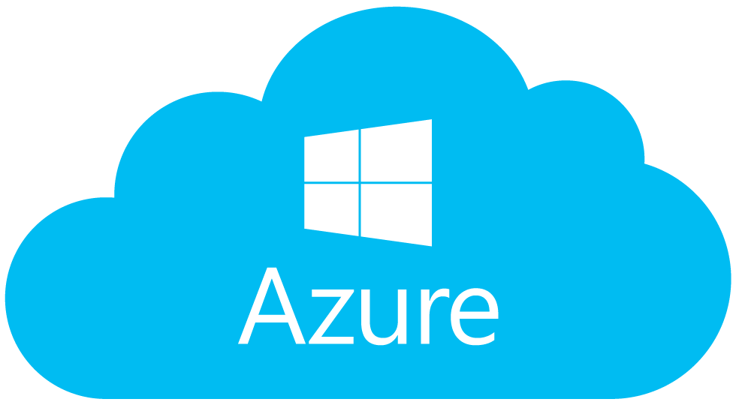
Built for Anyone who Uses Data
Analysts l Data Scientists l Data Engineers l Data Admins
A Single Platform for Any Use Case
ETL & Reporting l Ad Hoc Queries l Machine Learning l Streaming l Vertical Apps
Optimize performance, cost, and scale through automation, control and orchestration of big data workloads.
Open Source Engines, Optimized for the Cloud
Native Integration with multiple cloud providers
Notes:
At Qubole, our mission is to make Data Teams more successful. We do that by automating, controlling and orchestrating your big data workloads so that you can optimize performance, cost and scale.
Now, I know you know that there are a lot of Big Data players out there. It’s difficult to distinguish who does what when everyone is saying the same thing.
We’re different in four ways:
We’re built for anyone in your organization who uses data. That means your analysts, data scientists, data engineers and data admins can use Qubole.
We’re a single platform for any use case including ETL & Reporting, Ad Hoc Queries, Machine Learning, Streaming and Vertical Apps.
We support open source engines and we’re optimized for the cloud.
We’re cloud-native, cloud-optimized, and cloud-agnostic. We were born in the cloud and you’re free to use whichever cloud you want.

Slide 4
Presto
High Performance SQL Query Engine for Big Data
In-memory and pipelined execution model
Well suited for Adhoc and reporting use-cases
Gained huge popularity in recent years
More than 400% growth rate in Qubole in 2018

Slide 5
Spot Nodes
Surplus compute at AWS
Available at highly discounted price
Can be interrupted
Well suited for stateless services

Slide 6
Presto + Spot Nodes?
High Performance + lower cost
Obvious match?
NO
Presto is fault Intolerant
Good chances of Spot Node being interrupted
Query Failures around the interruption

Slide 7
Spot Loss

Slide 8
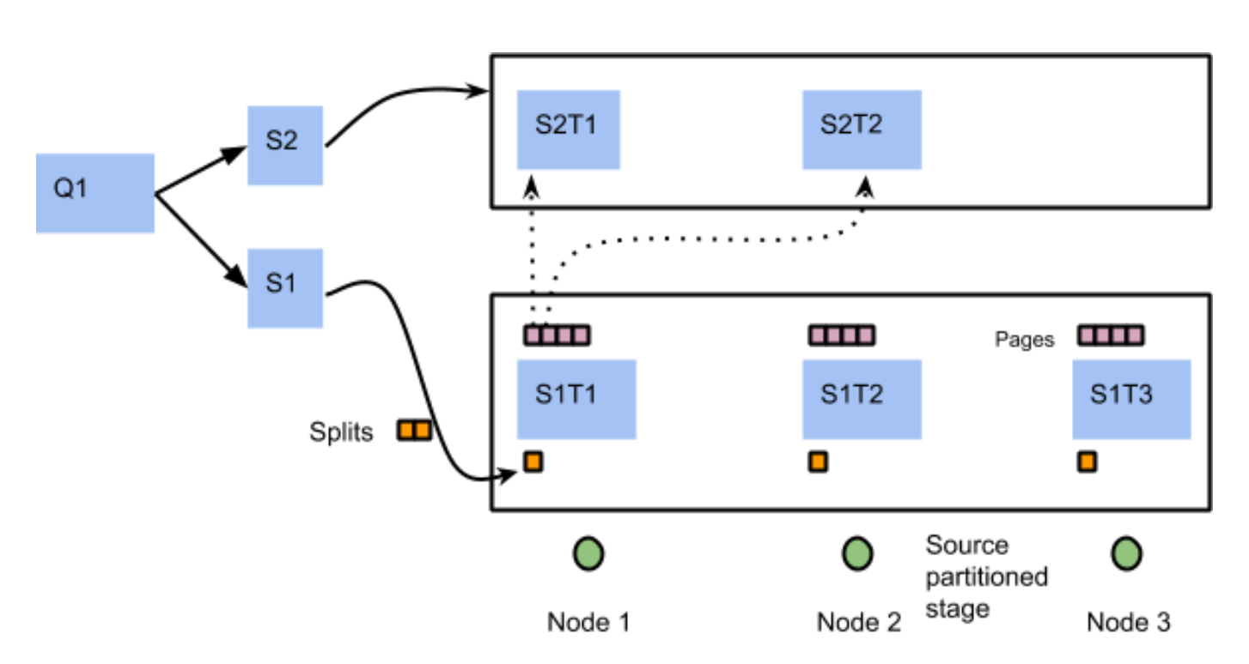
Presto's reasons for fault intolerance
In-Memory execution
Aggressive pipelining
Notes:
TODO: FIX S1T3
In-memory: comparison with hadoop. needed for performance
aggressive pipelining: needed for high cpu utilization, makes checkpointing hard

Slide 9
Qubole's journey of Presto on Spot Nodes
Maximum Spot Percentage
Management System for cluster with a mix of node types
Spot percentage in autoscaled nodes
Stable core size
Appropriate Fallbacks
Spot Rebalancer
More reliable than 100% spot cluster

Slide 10
Qubole's journey of Presto on Spot Nodes
Heterogeneous Clusters
Multiple Node Types
Multiple AZ support

Slide 11
Qubole's journey of Presto on Spot Nodes
Spot Termination Notification (STN)
2 minutes notice of interruption
STN Handling
Node Blacklisting
New node bringup
Spot rebalancer
Solves for short queries

Slide 12
Qubole's journey of Presto on Spot Nodes
Smart Query Retry
Cluster-aware Retry System
Provided through the Presto Server
Smart Query Retry Requirements
Avoid unnecessary retries
Wait for the rollback of failed query
Should not retry if partial results were returned
Retry should be transparent to Presto clients

Slide 13
Case Study
A service of several Presto clusters
Each cluster configured with min=15, max=25 and max 100% spot nodes in autoscaled nodes
Metrics collected around queries, nodes, ec2 events, query retries, etc
2-months sample period

Slide 14
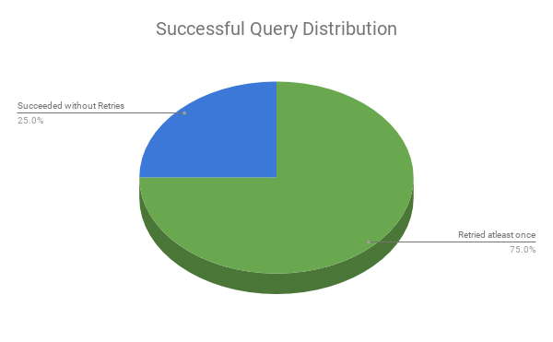
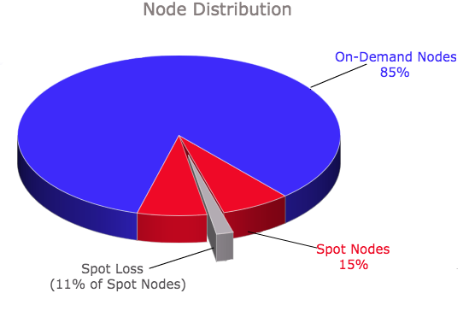
Case Study - Smart Query Retry Impact

Slide 15
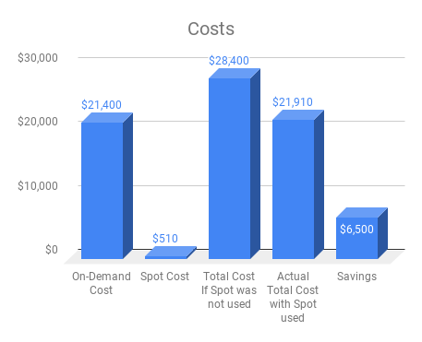
Case Study - Costs
Notes:
~32000 hours of OD
~6500 hours of spot

Slide 16
Conclusion
Spot nodes save considerable costs
AWS provides some features to minimize impact of spot interruptions
Smart Retries are needed to reliably leverage spot in Presto

Slide 17
Thanks and please Rate today ’s session
Session page on conference website
O’Reilly Events App

